Slide 1
Lessons Learned From Agile Quality Assurance In Scrum

Slide 2
The conceptual structure of an application to software testing
What types of test need to have to cover entire application?
What’re aspects of application those types of test cover?
What types of test need to have in a project?
GUI Unit Tests
Automated System Tests
Manual System Tests
Unit Tests
Integration Tests
Who creates system tests?
FA
What’s FA?
What does FA do?
Why FA?
SET
What’s SET?
What does SET do?
Why SET?
Introduce about ‘acceptance test-driven development’
Overview
Acceptance criteria & tests
Introduce about ‘code review’ and its benefit
Introduction
Benefit
Practices in testing software work with cloud-based APIs

Slide 3

Cross-cutting Infrastructure
User Interface
Business Logic
Data Access
Service Gateways
Data Source
External Services

Slide 4
GUI Unit Test
Cross-cutting Infrastructure
User Interface
Fake Business Logic
Business Logic
Data Access
Service Gateways

Slide 5
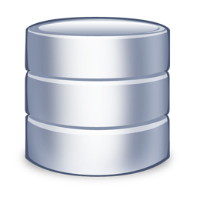
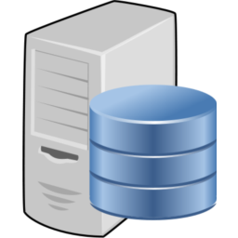

Source Repository
Build Server
Development Machine

